Slide 1


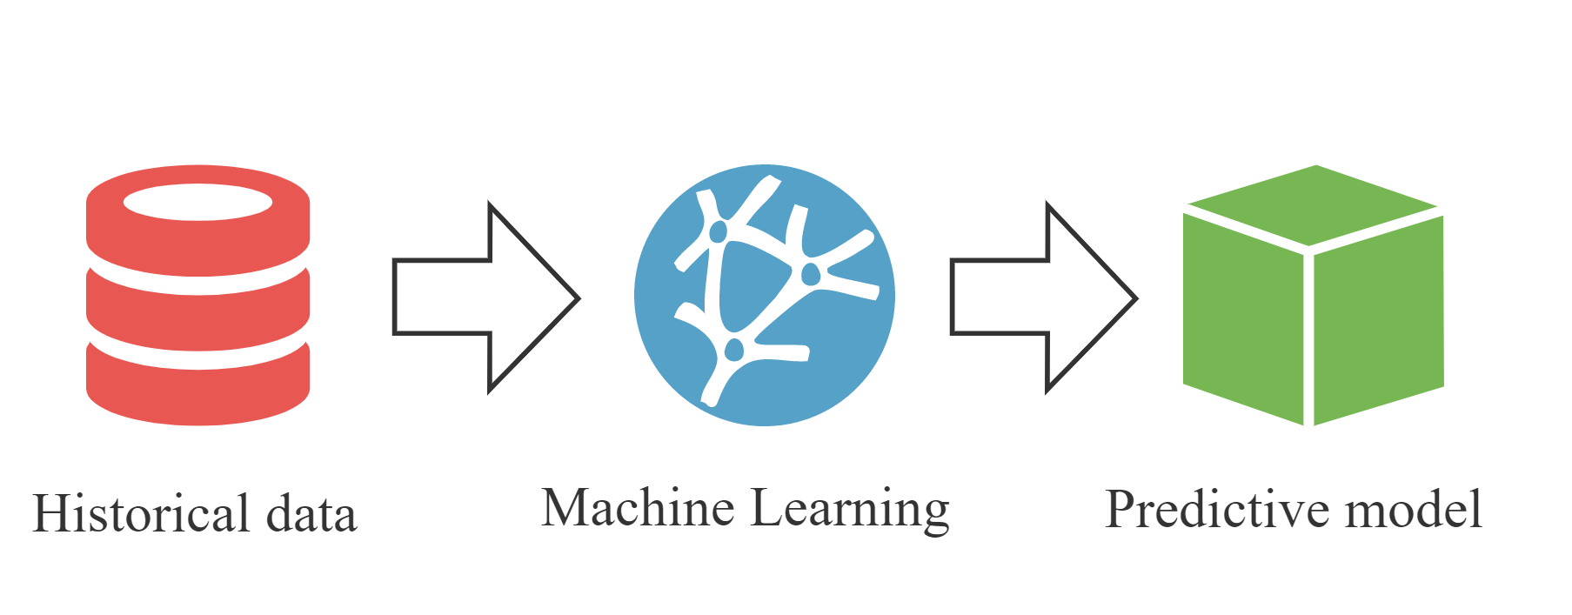
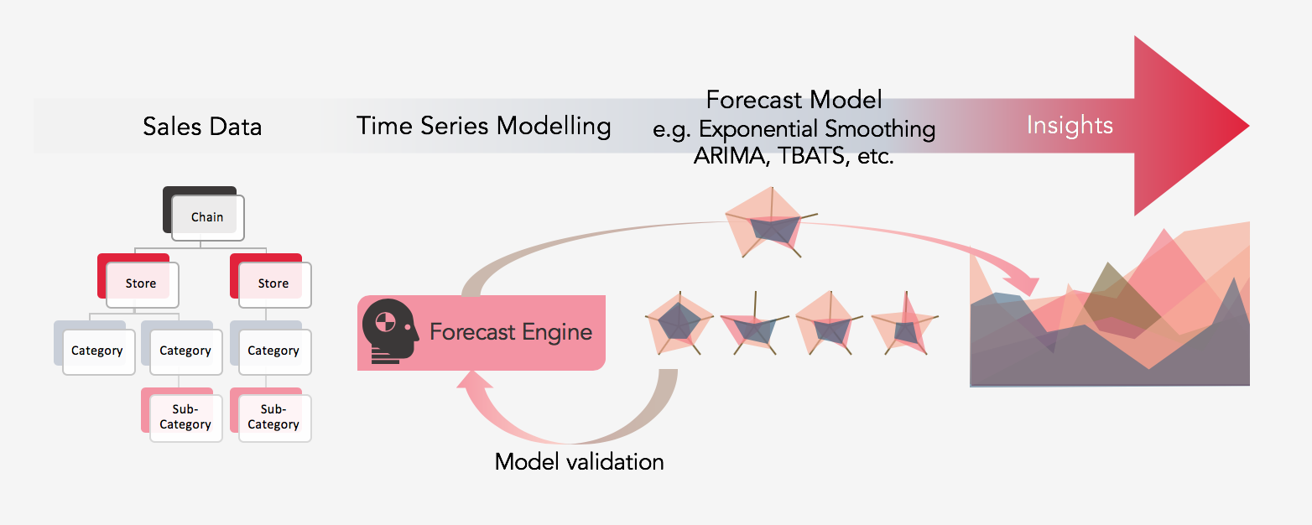
Future Sales Prediction using Machine Learning and Deep Learning Techniques
REPLACE THIS BOX WITH YOUR ORGANIZATION’S
HIGH RESOLUTION LOGO
Dhanesh Joy Rodriguse (10610107)
ABSTRACT
INTRODUCTION
METHODOLOGY
CONCLUSIONS
Accurate sales forecasting is crucial for businesses to optimize inventory management, allocate resources efficiently, and improve customer satisfaction. This study compares the performance of advanced machine learning techniques, including attention mechanisms, graph neural networks (GNNs), recurrent neural networks (RNNs), long short-term memory (LSTM) networks, autoregressive integrated moving average (ARIMA), and vector autoregression (VAR) models, for sales forecasting using the "Predict Future Sales" dataset from Kaggle. The results demonstrate the effectiveness of these techniques in capturing complex temporal and relational patterns in sales data, providing valuable insights for businesses to make data-driven decisions.
Sales forecasting plays a critical role in the success of a business. By accurately predicting future sales, businesses can manage inventory, allocate resources, and plan marketing strategies more effectively. Traditional sales forecasting methods, such as time series analysis and regression, have been widely used but may struggle with complex, high-dimensional datasets. The advent of advanced machine learning techniques, such as attention mechanisms and graph neural networks, has opened new avenues for improving sales forecasting. This study aims to investigate the performance of these techniques on the "Predict Future Sales" dataset from Kaggle, providing insights into their potential advantages and limitations.
The dataset consists of historical sales data for 3,340 products across 60 stores. The data includes daily sales records, item prices, and item category information.
Data Preprocessing :
• Impute missing values and remove outliers
• Aggregate the daily sales data into monthly sales data
• Encode categorical variables (e.g., item categories)
Feature Engineering :
•Extract temporal features (e.g., month, year, seasonality)
•calculate lagged features (e.g., sales and item prices from previous months)
•Construct features for GNNs (e.g., product relationships, store relationships)
Model Training and Evaluation :
•Split the dataset into training, validation, and test sets
•Train and tune the models (attention mechanisms, GNNs, RNNs, LSTM, ARIMA, VAR) using the training and validation sets
•Evaluate the models on the test set using performance metrics such as mean squared error (MSE) and mean absolute percentage error (MAPE)
Model Comparison :
•Compare the performance of the models on the test se
•Analyze the advantages and limitations of each technique
This study provides a comprehensive comparison of advanced machine learning techniques for sales forecasting using the "Predict Future Sales" dataset from Kaggle. By analyzing the performance of attention mechanisms, GNNs, RNNs, LSTM, ARIMA, and VAR models, the study offers valuable insights into the potential of these techniques in addressing complex sales forecasting problems. The findings will contribute to the development of more accurate and robust sales forecasting models, enabling businesses to make better-informed decisions and improve overall efficiency.
LITERATURE REVIEW
REFERENCES
The rapid advancement of technology and the growth of e-commerce have led to an explosion in the amount of data generated by businesses. Companies can leverage this data to gain insights and make data-driven decisions that improve their sales and operational efficiency. One area of particular interest is sales forecasting, which involves predicting future sales based on historical data and other factors. Accurate sales forecasts enable businesses to optimize inventory management, allocate resources efficiently, and improve customer satisfaction.
Machine learning (ML) and deep learning (DL) techniques have emerged as powerful tools for addressing complex forecasting problems in various domains, including sales forecasting. This literature review aims to explore the latest research in applying ML and DL techniques to future sales prediction and to identify the most promising methods and potential improvements.
1. Hyndman, R.J. & Athanasopoulos, G., 2018. Forecasting: principles and practice. OTexts.
2. Wang, R., 2021. Deep learning in retail demand forecasting: Challenges and applications. Decision Support Systems.
3. Agarwal, S., Chakraborty, S., & Bhowmik, P., 2019. Sales Forecasting using Ensemble Methods: A Case Study. In Proceedings of the 10th Indian Conference on Computer Vision, Graphics and Image Processing, pp. 1-8.
4. Chai, T., & Draxler, R.R., 2014. Root mean square error (RMSE) or mean absolute error (MAE)? Arguments against avoiding RMSE in the literature. Geoscientific Model Development, 7(3), 1247-1250.

